Slide 1
Millions of users now find it hard to imagine life without the internet - without email, instant messaging, web search engines and online trading or gaming.
Over the past decade since Online was launched, it's the web that has made the difference. It has made it easier to access all the net's facilities, and encouraged a huge explosion in the number and diversity of websites.
With the web still expanding, we have taken the opportunity to ask Online's readers, contributors, and some of the Guardian's journalists to suggest the 100 most useful sites.
It is a sign of the vast reach of the web that it was constricting to have to limit coverage to 20 categories with only five sites in each - a lot of great sites have not made the cut.
The Guardian has its own website which now has more than 9m unique users and delivers more than 100m page impressions a month.We have listed the most popular Guardian sites, and some Online readers' suggestions.
Today, almost half (49%) of British people now have internet access from home. With more and more information coming online, the benefits of being connected can only increase, and in the next decade, few lives will remain untouched by the web

Slide 2
Community
You should be able to find a community for any interest, however niche, on the web - but for geek news, the best port of call is Slashdot. Orkut, a site that lets you communicate with friends of friends has replaced Friendster as the peer network du jour, but those wanting to focus on their local area might visit Craigslist, an eBay-meets-Loot which now has sites for London, Manchester, Edinburgh and Dublin. Del.icio.us is a bookmark manager that lets you store and organise your web favourites and then share the sites you browse with others, while Flickr is an online photo gallery that lets other people look at (and comment on) your pictures

Slide 3
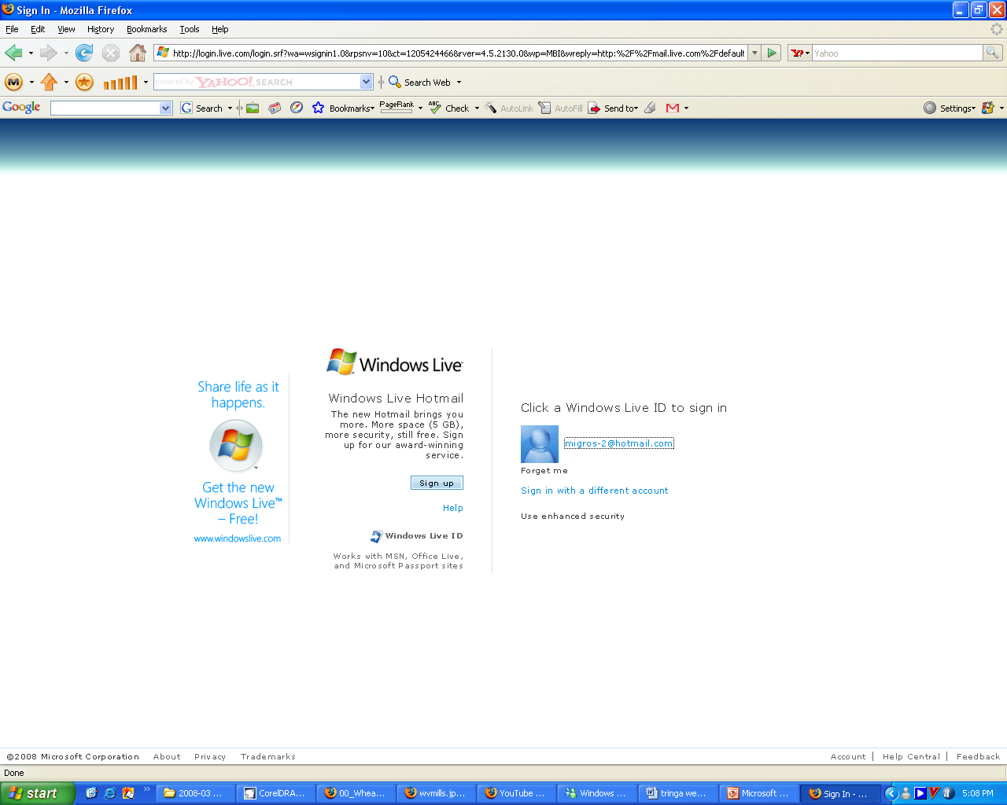
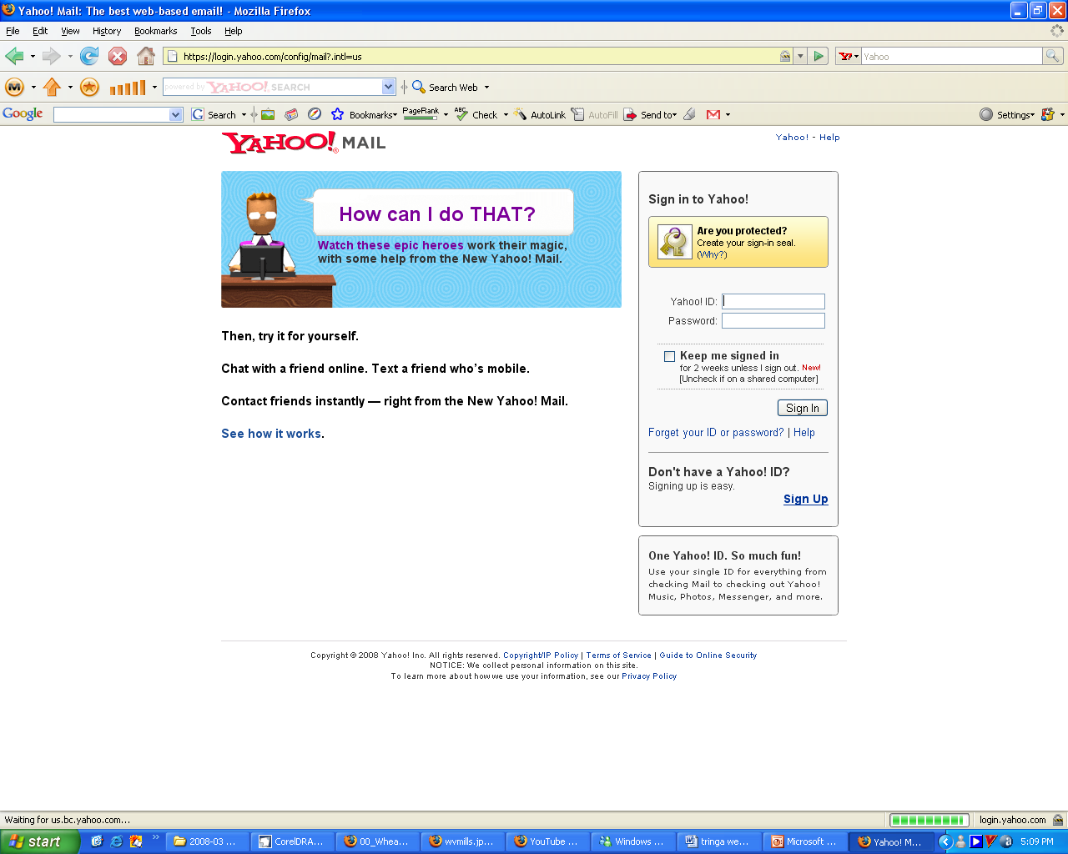
Email
Hotmail is the free email service everyone knows. It's also dangerous, because Microsoft will delete all your messages if you don't log on every 30 days. However, it's an obvious choice for people who use Microsoft Messenger, MSN Spaces (Microsoft's new blogging service), and Internet Explorer, because they all work together. But if you just want web-based email, go for Yahoo. It is cleaner and faster, and you can forward email to a phone or pager. Yahoo only provides 100 megabytes of free space, whereas Hotmail provides 250MB, and Google's Gmail a gigabyte (1GB). One drawback with Gmail is that you cannot sign up: you have to be invited. My first choice is Bluebottle. It's free, it offers 250MB of storage, and as well as web access, it supports POP3 and Imap, so you can use a proper email program from copy.

Slide 4
Health
There are more websites devoted to health than to almost any other subject, but some are more reliable than others. A slightly sceptical approach is probably healthiest, but the website of the National Electronic Library for Health brings together all the latest research evidence, safety and organisational concerns. There is even a "hitting the headlines" feature, where staff at the Centre for Reviews and Dissemination at York University assess the reliability of health correspondents' reporting! The Health Protection Agency (formerly Public Health Laboratory Service) has masses of information, including all the symptoms, facts and figures you could ever want on infectious diseases, while the Food Standards Agency is commendably rapid at publishing agendas and minutes of scientific advisory committees, as well as food safety alerts. The British Medical Journal has been unusual among medical journals in allowing free access to all articles past and present, though some limited restrictions are coming inforce from January. Avert is the website of an international Aids charity which has brilliant statistical data and explanations of the science that anyone can understand

Slide 5
Science
Yahoo can be worth checking two or three times a day. Eurkalert was deliberately created by the American Association for the Advancement of Science as a forum for formal science press announcements, and that, too, merits a daily visit: over the years, it has become a research resource in itself. Space.com is an impressive, eclectic place. But the best for almost a decade has been, and is still, Nasa.gov. There's plenty of government, but also a wealth of delicious arcana, including the Lunar Surface Journal, a transcript of all the conversations on the moon, annotated by the Apollo astronauts themselves

Slide 6
Search
Search is still the jewel of the web: the ability to extract information on any subject in a fraction of a second. Search engines can now scour hard disks, news groups, images, blogs, emails and peer-to-peer sites as well as the web. Some can do nearly all of these simultaneously. Google remains king of the jungle but Yahoo - which now owns Overture, AllTheWeb and AltaVista (number one choice in the pre-Google era) - is snapping at its heels, leaving MSN Search a distant third. One of the most interesting new sites - though the consumer experience doesn't yet live up to the hype - is Blinkx. It claims to search more sources simultaneously (including hard disks, video and peer-to-peer) than anyone else, using artificial intelligence to interpret the context of what you are saying rather than Google's page rankings (PCs only until January).

Slide 7
Reference
The web is often the quickest place to look something up - if you know where to go. If you don't, you can always start with Jim Martindale's Reference Desk, an astonishing collection that has been 10 years in the making. Usually, however, you will probably want to look up a word, a phone number, a place or whatever. For words, try Onelook, which indexes more than 6m words in 981 dictionaries. It also has a "reverse lookup" to find words from their meanings. For longer items, the Concise Columbia Electronic Encyclopedia is online (the Britannica costs money). There are links to the world's online phone books at Teldir, which is now on the Infobel site. Finally, there are maps of just about everywhere at Multimaps

